Slide 1

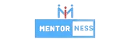
Hotel
Reservation Analysis
Yassmin Abd El Monsif
HOTEL ANALYSIS

Slide 2

INDEX
Data is very much essential to the hotel sector in order to make well-informed decisions and improve the overall visitor experience. In this project, we have to examine a large dataset of hotel reservations in order to derive important insights. Our objectives is to determine visitor preferences, spot patterns in booking behavior, and identify critical elements that impacts the hotel's operations..
Project
Overview

Slide 3


INTRODUCTION
Objectives
Our goal is to use SQL for comprehensive dataset exploration and analysis. Its main motive is to uncover patterns through the dataset's specialized queries, which will inform us the strategic choices and maximize the hotel's overall performance.
01

Slide 4
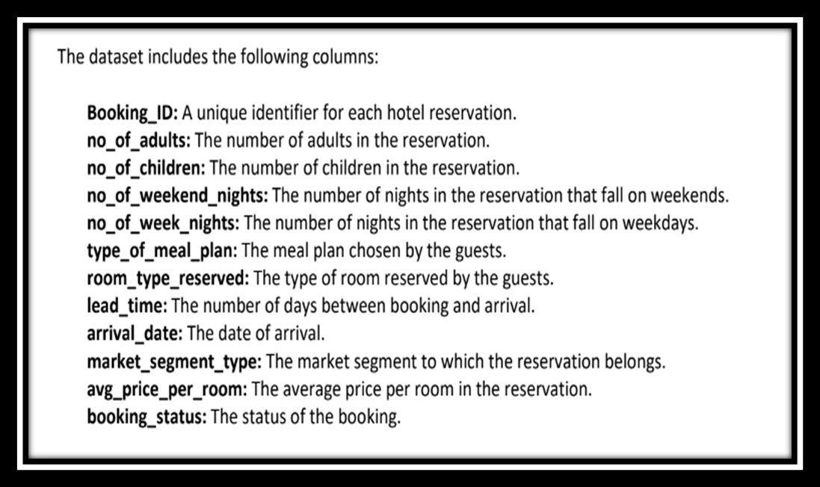
Dataset Overview
02

Slide 5
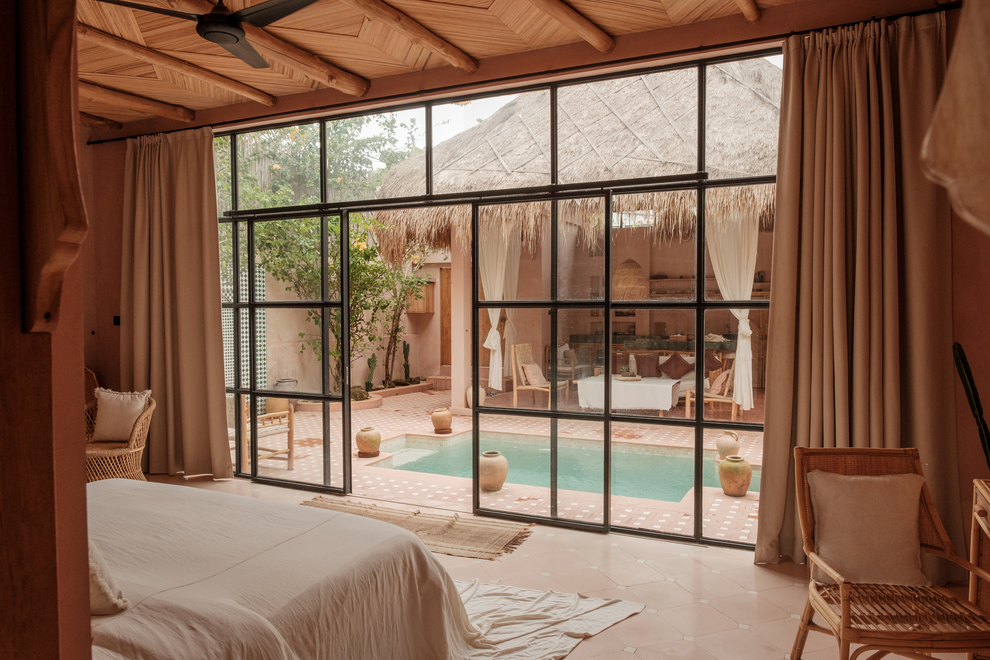

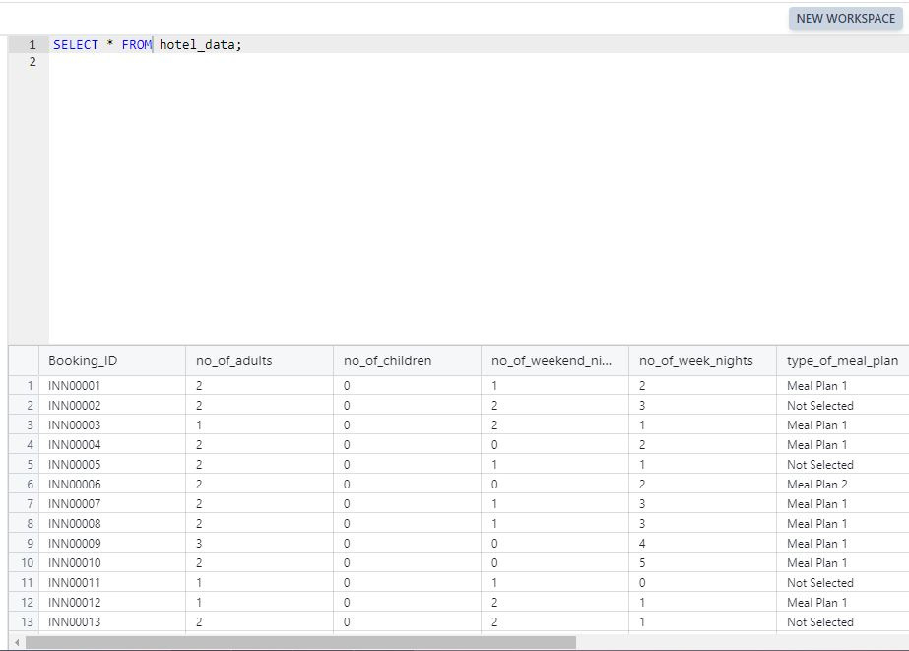
03

Slide 6
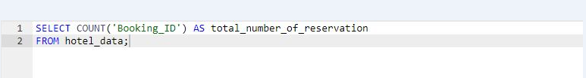
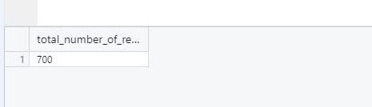
DATA ANALYSIS QUERIES
1. What is the total number of reservations in the dataset?
04

Slide 7
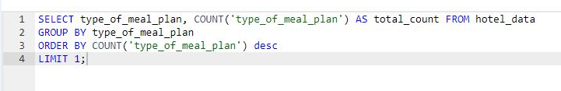
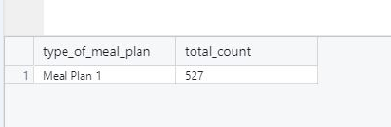
DATA ANALYSIS QUERIES
2. Which meal plan is the most popular among guests?
05

Slide 8
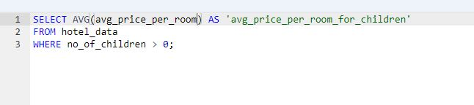
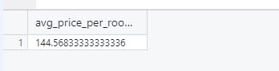
DATA ANALYSIS QUERIES
3. What is the average price per room for reservations involving children?
06

Slide 9
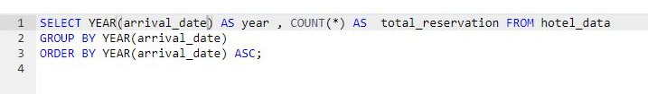
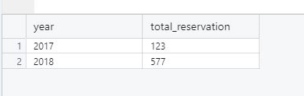
DATA ANALYSIS QUERIES
4.How many reservations were made for the year 20XX (replace XX with the desired year)?
07

Slide 10
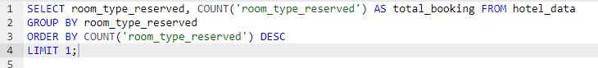
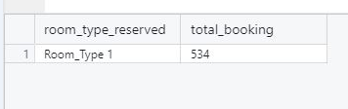
DATA ANALYSIS QUERIES
5. What is the most commonly booked room type?
08

Slide 11
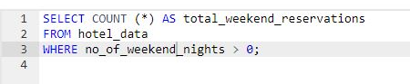
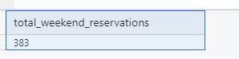
DATA ANALYSIS QUERIES
6. How many reservations fall on a weekend (no_of_weekend_nights > 0)?
09

Slide 12
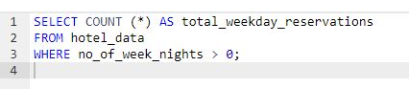
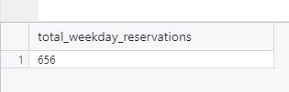
DATA ANALYSIS QUERIES
6. How many reservations fall on a weekend (no_of_weekend_nights > 0)?
10

Slide 13
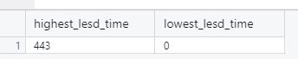
DATA ANALYSIS QUERIES
7. What is the highest and lowest lead time for reservations?
11

Slide 14
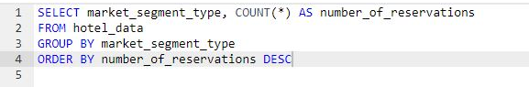
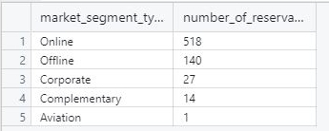
DATA ANALYSIS QUERIES
8. What is the most common market segment type for reservations?
12

Slide 15
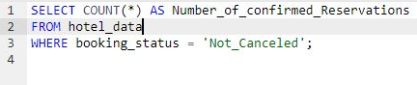
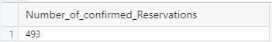
DATA ANALYSIS QUERIES
9. How many reservations have a booking status of "Confirmed"?
13

Slide 16
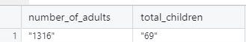
DATA ANALYSIS QUERIES
10. What is the total number of adults and children across all reservations?
14

Slide 17
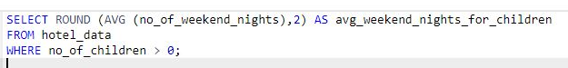
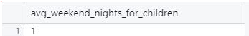
DATA ANALYSIS QUERIES
11. What is the average number of weekend nights for reservations involving children?
15

Slide 18
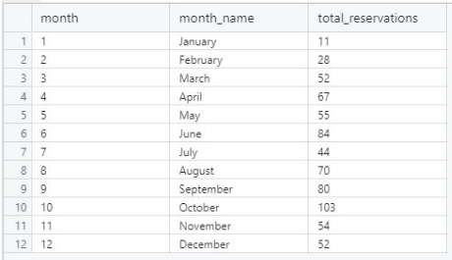
DATA ANALYSIS QUERIES
12. How many reservations were made in each month of the year?
16

Slide 19
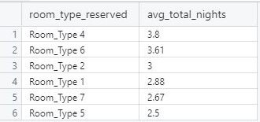
DATA ANALYSIS QUERIES
13. What is the average number of nights (both weekend and weekday) spent by guests for each room type?
17

Slide 20
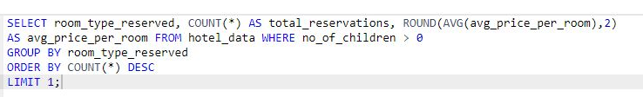
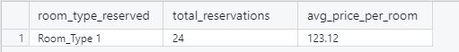
DATA ANALYSIS QUERIES
14. For reservations involving children, what is the most common room type, and what is the average price for that room type?
18

Slide 21
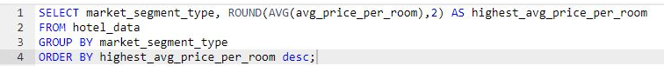
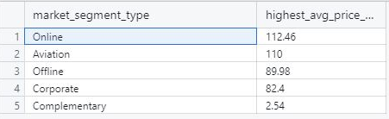
DATA ANALYSIS QUERIES
15. Find the market segment type that generates the highest average price per room.
19

Slide 22

HOTEL DATA ANALYSIS
Overall Insight
The dataset comprises 700 bookings.
Meal Plan 1 is the most popular among guests.
Bookings that include children have a mean room cost of 144.6.
The number of reservations rose significantly from 123 in 2017 to a higher figure in 2018.
20

Slide 23
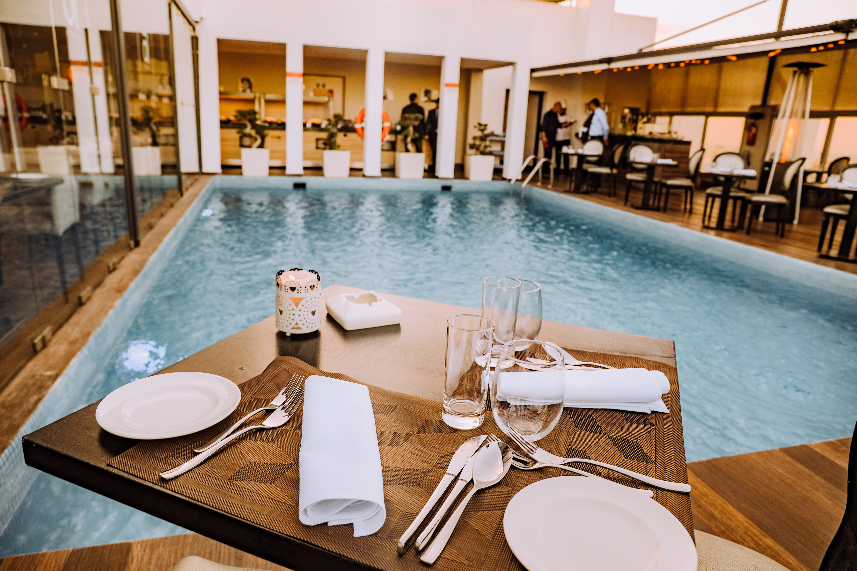
HOTEL DATA ANALYSIS
Overall Insight
Room Type 1 is the most frequently booked.
Mostly guests (656) opt for weekday stays
than weekend stays (383).
Booking behaviors vary, with lead times from 0 to 443 days.
The online segment is the most frequently used for bookings.
Out of 700 bookings, 493 are confirmed.
The majority of bookings (1,316) which are made by adults.
(1) is an average number of weekend nights for
reservations involving children
21

Slide 24
HOTEL DATA ANALYSIS
Overall Insight
October is the busiest month for bookings,
while January has the fewest.
For bookings that include children, Room Type 1 is the top choice, with an average room cost of 123.12.
Online bookings yield the highest average room cost, at 112.46.
Average number of nights (both weekend and weekday)
22

Slide 25
Thank You for Watching

